Slide 1

Introduction to NLP

Slide 2

Empowering Mankind
MySkill - Empowering womanhood, is program with a vision to give a platform to all the women for diversifying their existing skills to meet today's challenges. MySkill aims at building actual competencies to achieve their highest desired level of independence and inclusion in their communities.
MySkill has partnered with institutes who have a proven track record of training and empowering women through various educational and experiential learning in the past.
MySkill offers a platform for all aspiring women who want to have a greater expansion in professional and personal growth which in turn contribute to structural transformation and economic growth by enhancing employability.

Slide 3
Agenda
Understanding the Basics of NLP
Purpose of NLP
History of NLP
Principles of NLP
Applications of NLP in Everyday Life
Key NLP Techniques: Anchoring and Reframing
Visualization and Modeling in NLP
Advanced Techniques: Swish Patterns and Timelines
Metaphor, Storytelling, and Role Playing
Feedback and Reflection in NLP
Conclusion on NLP Techniques

Slide 4

Understanding the Basics of NLP
Basics
Plus tip:
Consider adding examples of how NLP can be used in real-life situations to illustrate its practical applications.
Neuro Linguistic Programming (NLP) is a psychological approach that involves understanding and changing human behavior patterns through the relationship between language, thought processes, and emotional states.
It focuses on the connection between neurological processes ('neuro'), language ('linguistic'), and behavioral patterns learned through experience ('programming').

Slide 5
Purpose of NLP
Objectives
Plus tip:
Consider adding specific examples of NLP techniques that aid in communication and personal development.
Enhancing Communication and Relationships
NLP provides tools and techniques to improve self-awareness and emotional intelligence.
It enhances interpersonal communication and relationship building.
NLP strategies foster effective communication in personal and professional settings.
Facilitating Personal Development
NLP helps modify unhelpful behaviors and thought patterns.
It assists individuals in achieving personal and professional goals.
Techniques empower individuals to overcome fears and limiting beliefs.

Slide 6
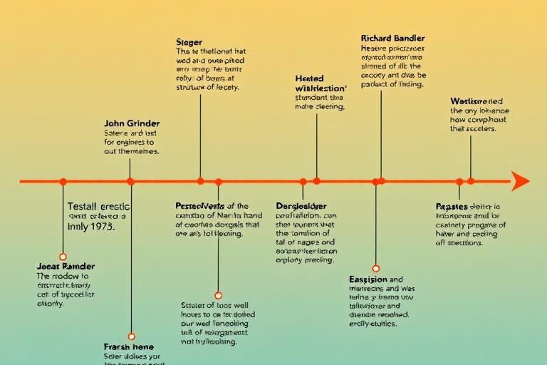
History of NLP
Foundations
Origins and Evolution of NLP
NLP was developed in the 1970s by Richard Bandler, a mathematician, and John Grinder, a linguist.
They studied successful therapists, including Fritz Perls (Gestalt therapy), Virginia Satir (family therapy), and Milton Erickson (hypnotherapy).
By analyzing their techniques, Bandler and Grinder identified key patterns in effective communication and behavior change.
The first book on NLP, 'The Structure of Magic,' published in 1975, laid the groundwork for the methodology.
Over the years, NLP has evolved, gaining popularity in various fields such as psychotherapy, coaching, education, and business.
Plus tip:
Consider adding more recent examples of NLP applications in modern therapy or coaching to illustrate its ongoing evolution.

Slide 7
Principles of NLP
Principles
Plus tip:
Consider expanding on each principle with real-life examples or anecdotes to enhance understanding.
The Map is Not the Territory
Every Behavior Has a Positive Intention
Rapport and Flexibility
This principle emphasizes that our perceptions of the world are subjective. People interpret experiences differently based on their beliefs and backgrounds.
NLP posits that all behaviors, even those that seem negative, are driven by positive intentions. Understanding this can foster compassion and change.
Building rapport is essential for effective communication. Successful individuals are adaptable and can change their approach based on feedback from their environment.

Slide 8
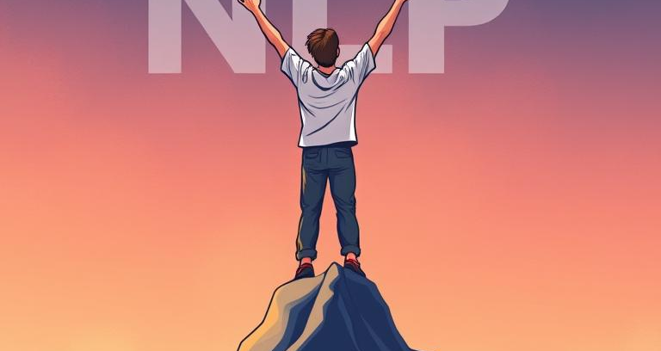


Applications of NLP in Everyday Life
Application
Plus tip:
Consider adding examples of specific NLP techniques used in each area to enhance the content.
Personal Development
NLP techniques can help individuals overcome fears, phobias, and limiting beliefs, fostering greater confidence and resilience.
Communication Skills
Learning to use language effectively can improve personal and professional relationships. NLP teaches strategies for active listening, persuasive communication, and nonverbal cues.
Business and Leadership
NLP is applied in sales, negotiation, and team dynamics to enhance communication, leadership skills, and performance.

Slide 9
Key NLP Techniques: Anchoring and Reframing
Techniques
Plus tip:
Consider providing specific examples of how these techniques can be applied in real-life situations.
Anchoring
Anchoring involves creating a mental or emotional 'anchor' that triggers a desired emotional state.
Participants recall a powerful, positive experience while associating it with a specific gesture or word.
This anchor can be used later to evoke that positive state on demand.
Reframing
Reframing changes the way an individual perceives a situation, allowing for different perspectives.
Participants identify a negative thought and find alternative interpretations or positive outcomes.
This technique helps individuals see situations in a more constructive light.

Slide 10
Visualization and Modeling in NLP
Techniques
Plus tip:
Consider including examples of successful individuals who have utilized these techniques in their fields to make the content more relatable.
Visualization Techniques
Visualization uses mental imagery to create vivid scenarios representing desired outcomes.
Individuals visualize themselves achieving goals or overcoming challenges, enhancing motivation and confidence.
This technique can help in reinforcing positive behaviors and outcomes by mentally rehearsing success.
Modeling Techniques
Modeling involves observing and replicating the behaviors, beliefs, and strategies of successful individuals.
Participants study a role model’s approach in specific areas, such as communication or negotiation.
By practicing similar techniques, individuals can improve their own performance significantly.

Slide 11
Advanced Techniques: Swish Patterns and Timelines
Techniques
Plus tip:
Consider adding examples of how Swish Patterns and Timelines can be applied in real-life situations for better understanding.
Swish Patterns
This technique changes unwanted behaviors by replacing them with desirable ones.
Participants visualize the unwanted behavior alongside a negative image.
They then replace it with a positive image of the desired behavior, creating a 'swish' effect.
This process helps in creating a strong association with positive actions.
Timelines
Timelines facilitate visualization of past, present, and future experiences.
Participants create a timeline of significant life events to identify patterns.
This technique allows for reframing and goal setting based on past experiences.
It aids in understanding how past events influence current behaviors.

Slide 12
Metaphor, Storytelling, and Role Playing
Applications
Plus tip:
Consider adding examples of specific metaphors or role-playing scenarios to illustrate their effectiveness in NLP.
Use of Metaphors
Using metaphors can help convey complex ideas and facilitate emotional connections. Practitioners craft or share stories that illustrate specific lessons or insights, aiding individuals in understanding and integrating new concepts.
Role Playing Techniques
Roleplaying allows individuals to practice new behaviors in a safe environment. Participants take on different roles to simulate real-life situations, enabling them to experiment with communication styles and strategies.
Impact on Learning and Change
Both storytelling and role playing enhance engagement in the learning process, making it easier for individuals to internalize concepts and apply them in real-world contexts.

Slide 13
Feedback and Reflection in NLP
Principles
Feedback and reflection are crucial components of Neuro Linguistic Programming (NLP) for fostering personal growth and enhancing self-awareness. Gathering feedback allows individuals to engage in self-reflection and seek insights from others about their behaviors and communication styles, facilitating continuous improvement. This process helps individuals identify patterns and beliefs, enabling them to reframe negative thoughts and reinforce positive behaviors, thus promoting meaningful transformation in their personal and professional lives.
Plus tip:
Consider adding personal examples or case studies that illustrate the impact of feedback and reflection in NLP.

Slide 14
NLP techniques offer valuable tools for personal and professional development.
Plus tip:
Conclusion
Consider adding specific examples or case studies of individuals or organizations that have successfully implemented NLP techniques to illustrate their benefits.
Neuro Linguistic Programming (NLP) provides activities and techniques designed to facilitate personal growth, improve communication, and enable behavioral change. Techniques like anchoring, reframing, and visualization enhance self-awareness and emotional intelligence. By engaging in these methods, individuals can foster positive change and achieve their goals effectively, making NLP a versatile framework for transformation.

Slide 15

MySkool is an inspiration for schools, teachers, parents and students to excel in life. It is a message that ‘good is always appreciated.’ It is a push towards self motivation, an opportunity to see how others are growing and a chance to appreciate fellow human beings.

